Slide 1
PROJECT TITLE
PIP104 PROFESSIONAL PRACTICE-II
VIVA-VOCE
Batch Number:
Roll Number | Student Name
20201CSD0103 20201CSD0103 20201CSD0107 20201CSD0070 20201CSD0094 | Chinna Obaiahgari Likitha Sallapram Yaswanth Veerapureddy Suvarna Chandrika Reddy Tholla Ananth Kumar Korrapati Pavan Kalyan Gowd
Under the Supervision of,
Dr. V. Chandra Sekar
Professor
School of Computer Science & Engineering
Presidency University

Slide 2
Introduction
The stock market is dynamic, unpredictable, and non-linear, making it challenging to predict stock prices. Two main approaches are technical analysis and qualitative analysis. Technical analysis uses historical stock prices and volume traded to predict future stock prices, while qualitative analysis considers external factors like company profile, market situation, political and economic factors, and financial news. Stock market prediction systems are essential tools for stock traders, but predicting price movements is difficult due to the Efficient Market Hypothesis, which suggests that prices reflect all available information.
A proposed system uses machine learning techniques and LSTM algorithm to predict stock prices based on previous stock data. This approach aims to maximize profit and minimize losses in the stock market.

Slide 3
Literature Review
P. K. Bharne and S. S. Prabhune : This paper presents the basic idea and principles of swarm intelligence and its applicability for daily stock market price optimization. Also, presents the basic algorithms of swarm intelligence including ACO, PSO, BAT, Firefly etc. From the survey, they conclude that the SI-ANN produce more optimized results that the SI with machine learning algorithms. They presented the comparative analysis of recent SI based approaches along with some future trends.
Mehar Vijha , Deeksha Chandolab, Vinay Anand Tikkiwalb, Arun Kumarc : The historical dataset available on company’s website consists of only few features like high, low, open, close, adjacent close value of stock prices, volume of shares traded etc., which are not sufficient enough. To obtain higher accuracy in the predicted price value new variables have been created using the existing variables. ANN is used for predicting the next day closing price of the stock and for a comparative analysis, RF is also implemented. The comparative analysis based on RMSE, MAPE and MBE values clearly indicate that ANN gives better prediction of stock prices as compared to RF.

Slide 4
Literature Review
Hegazy, Osman & Soliman, Omar S : This paper, proposed a machine learning model that integrates particle swarm optimization (PSO) algorithm and LS-SVM for stock price prediction using financial technical indicators. These indicators include relative strength index, money flow index, exponential moving average, stochastic oscillator and moving average convergence/divergence The PSO is employed iteratively as global optimization algorithm to optimize LS-SVM for stock price prediction. LS-SVM-PSO achieves the lowest error value followed by single LS-SVM, while ANN-BP algorithm is the worst one.
B. B. P. Maurya, A. Ray, A. Upadhyay, B. Gour and A. U. Khan : The Machine Learning model developed to anticipate the stock an incentive with additional precision when contrasted with recently executed machine learning models. This model is more efficient because it takes latest technical indicators - MACD, P/R and Moving Averages as input for the stock prediction. Moving Averages has been used to identify support and Resistance which helps in identifying the range of stock price value.By using web scraping the data is taken directly from the stock market and thus making it real and efficient. The model is trained to tackle real-world as well as real time stock problems.

Slide 5
Literature Review
I. Bhattacharjee and P. Bhattacharja : A comparative study between statistical approaches and machine learning approaches has been done in terms of prediction performances and accuracy. After studying all the methods individually, machine learning methods, especially, MLP and LSTM are found to be the most accurate to predict stock prices for having the least MSE and MAPE values.Predictions has been performed and performance measures have been calculated in terms of Mean Squared Error and Mean Absolute Percentage Error for all the applied methods.
U. Pasupulety, A. Abdullah Anees, S. Anmol and B. R. Mohan : In this work, they propose a systematic approach for Stock Prediction using Ensemble Learning and Sentiment Analysis. We make use of SVM and Extremely Randomized trees and improve the predicted price based on the individual models accuracy using a Stacked Regressor. Public opinion is mined from tweets using sentiment analysis and is used as an additional feature(in the form of positive/negative tweet counts) in the stock dataset.

Slide 6
Research Gaps Identification
Current sentiment analysis models for stock price prediction have limitations in generalization across markets, focusing on data from specific markets. They neglect the dynamic nature of sentiment and its impact on stock prices over time.
Future research could explore temporal dynamics and the influence of short- and long-term sentiment shifts on stock prices. Additionally, personalized sentiment analysis could be explored, assigning varying weights to users based on their past performance. Furthermore, many machine learning models lack transparency and interpretability, posing challenges in gaining trust and adoption within the financial industry. Addressing these research gaps could strengthen sentiment analysis models for stock price prediction.

Slide 7
Proposed Methodology
A Stock Price Dataset is taken.
The dataset is loaded and preprocessed with various machine learning techniques.
The preprocessed data is divided as training and testing data.
The prediction model is built using machine learning algorithm LSTM (Long Short Term Memory).
The model is trained using training dataset and once the model has been trained successfully it has to be tested.

Slide 8
The trained model is tested using testing dataset.
The finalized model is converted into h5 (Hierarchical Data Format 5) and saved.
A Front End is developed with the help of Flask and HTML.
Now user will enter the input that is which date stock price to predict in the front end.
The collected date from the front end is given as input to our finalized algorithm to predict stock price of that date.
Finally the predicted output is displayed on the front end.

Slide 9
Objectives
The main aim of this project to predict the stock price using machine learning techniques and LSTM (Long Short Term Memory) algorithm by considering previous stock data.
Evaluate the effectiveness of LSTM and sentiment analysis in comparison to traditional stock prediction methods like technical and fundamental analysis.
Identify the key factors influencing investor sentiment and their impact on stock price movements.
Develop a comprehensive methodology for data pre-processing, feature engineering, and model training and evaluation.
Create a user-friendly interface or system that incorporates the prediction model for easy access and utilization by investors.
Contribute to the field of financial machine learning research by advancing the capabilities of sentiment analysis-based stock prediction.

Slide 10
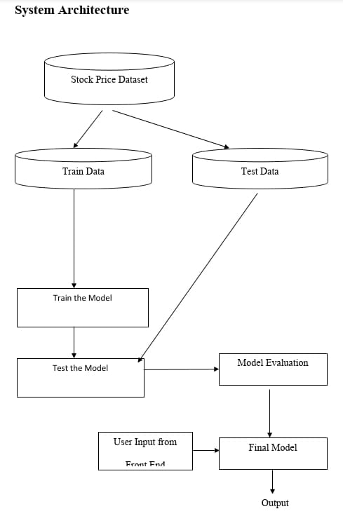
System Design & Implementation

Slide 11
System Design & Implementation
Stock Price dataset is taken and loaded.
The data is preprocessed to clean the data and understand the dataset.
The data is split as training and testing data.
The model is built using machine learning algorithm LSTM (Long Short Term Memory).
The model is trained with the preprocessed data.
The model is tested.
The final model will predict stock price based on user given new data from front end.

Slide 12
System Design & Implementation
Implementation:
Python:
Python is an interpreted, object-oriented, high-level programming language with dynamic semantics. Its high-level built in data structures, combined with dynamic typing and dynamic binding, make it very attractive for Rapid Application Development, as well as for use as a scripting language. Python's simple, easy to learn syntax emphasizes readability and therefore reduces the cost of program maintenance. Python supports modules and packages, which encourages program modularity and code reuse. The Python interpreter and the extensive standard library are available as open source. Python is widely considered as the preferred language for teaching and learning ML (Machine Learning).

Slide 13
System Design & Implementation
Features :
Easy to code
Free and Open Source
Object-Oriented Language
High-Level Language
Extensible feature
Python is Portable language
Python is Integrated language
Interpreted Language
Large Standard Library
Dynamically Typed Language

Slide 14
System Design & Implementation
Python IDLE :
An IDE (or Integrated Development Environment) is a program dedicated to software development.
IDEs integrate several tools specifically designed for software development. These tools usually include:
An editor designed to handle code (with, for example, syntax highlighting and auto-completion)
Its major features include the Python shell window(interactive interpreter), auto-completion, syntax highlighting, smart indentation, and a basic integrated debugger.
Python version 3.6.8 was utilized in our analysis.

Slide 15
System Design & Implementation
Long Short-Term Memoy (LSTM):
Recurrent Neural Network (RNN) variant: processes information sequentially with internal memory.
Cell State: internal memory, belt to store information across time steps.
Gates: control information flow into and out of the cell state:
Forget Gate: decides what information to discard from the previous state.
Input Gate: decides what new information to store in the current state.
Output Gate: decides what information from the current state to expose to the rest of the network

Slide 16
Dense Algorithm:
In the case of stock price prediction, LSTM (Long Short-Term Memory) models are commonly utilized to capture the underlying long-term dependencies present in stock data. However, relying only on LSTM models may not suffice to capture all the smaller and more immediate patterns in the stock data. This is where Dense layers play a crucial role..

Slide 17
System Design & Implementation
Dense layers, also known as fully connected layers, represent a type of neural network layer where each input node is connected to every output node.Dense layers serve the purpose of performing classification on the features extracted by the LSTM. They take the high-level, abstract representations obtained from the LSTM layers and transform them into predictions tailored to the specific task, such as predicting the closing price of a stock
Linear Regression:
Linear regression, a statistical method, is utilized in stock price prediction alongside sentiment analysis. Historical stock data (e.g., open, high, low, close prices) and sentiment data (from news, social media) are collected. Sentiment analysis generates numerical scores representing sentiments. These scores become additional factors for predicting stock prices. The model, trained using linear regression, correlates historical data with sentiment scores to forecast future stock prices based on sentiment trends.

Slide 18
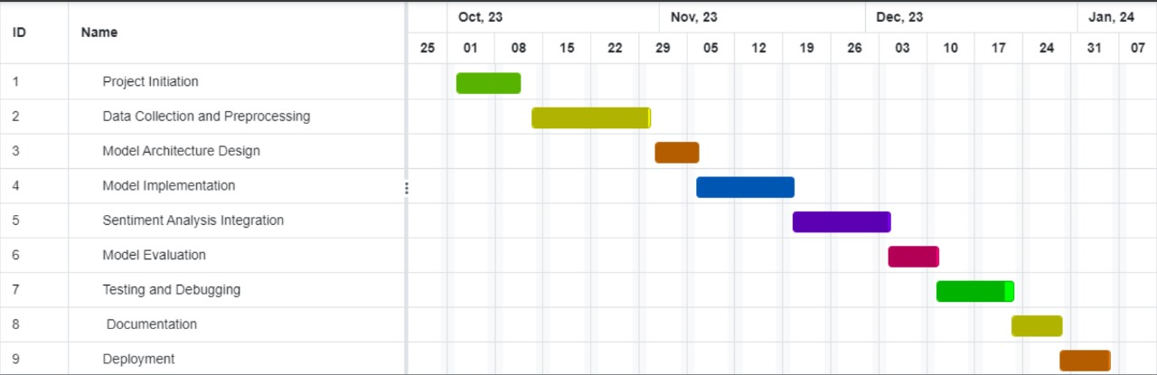
Timeline of Project

Slide 19
Outcomes / Results Obtained
Combining LSTM, KNN, and Dense algorithms in stock price prediction can provide valuable insights and enhance forecasting accuracy.
Sentiment Analysis Integration:
Sentiment analysis is integrated into stock price prediction models to capture market mood and public perception. Positive sentiment suggests potential increases, while negative sentiment suggests a downturn.
LSTM (Long Short-Term Memory) Integration:
LSTM, a long-term memory model, is ideal for analyzing time-series data like stock prices, as it effectively learns and remembers patterns over extended periods, enhancing predictions based on historical trends.

Slide 20
Outcomes / Results Obtained
KNN (K-Nearest Neighbors) Integration:
KNN integration in stock price prediction can identify patterns in data without strong assumptions, leveraging collective knowledge from past situations. This helps identify similarities between current market conditions and historical instances.
Dense (Fully Connected) Layers:
Dense layers in a model provide flexibility, capturing complex relationships between features like sentiment scores and historical stock prices, and learning intricate patterns, contributing to a comprehensive understanding of stock price movements.
The integration of sentiment analysis with LSTM, KNN, and dense algorithms in stock price prediction enhances forecasting accuracy, but it also faces limitations such as inaccuracies and stock market unpredictability. Continuous refinement, validation, and consideration of these limitations are crucial for its practical application in real-world financial scenarios. Cross-validation techniques can help mitigate overfitting issues.

Slide 21
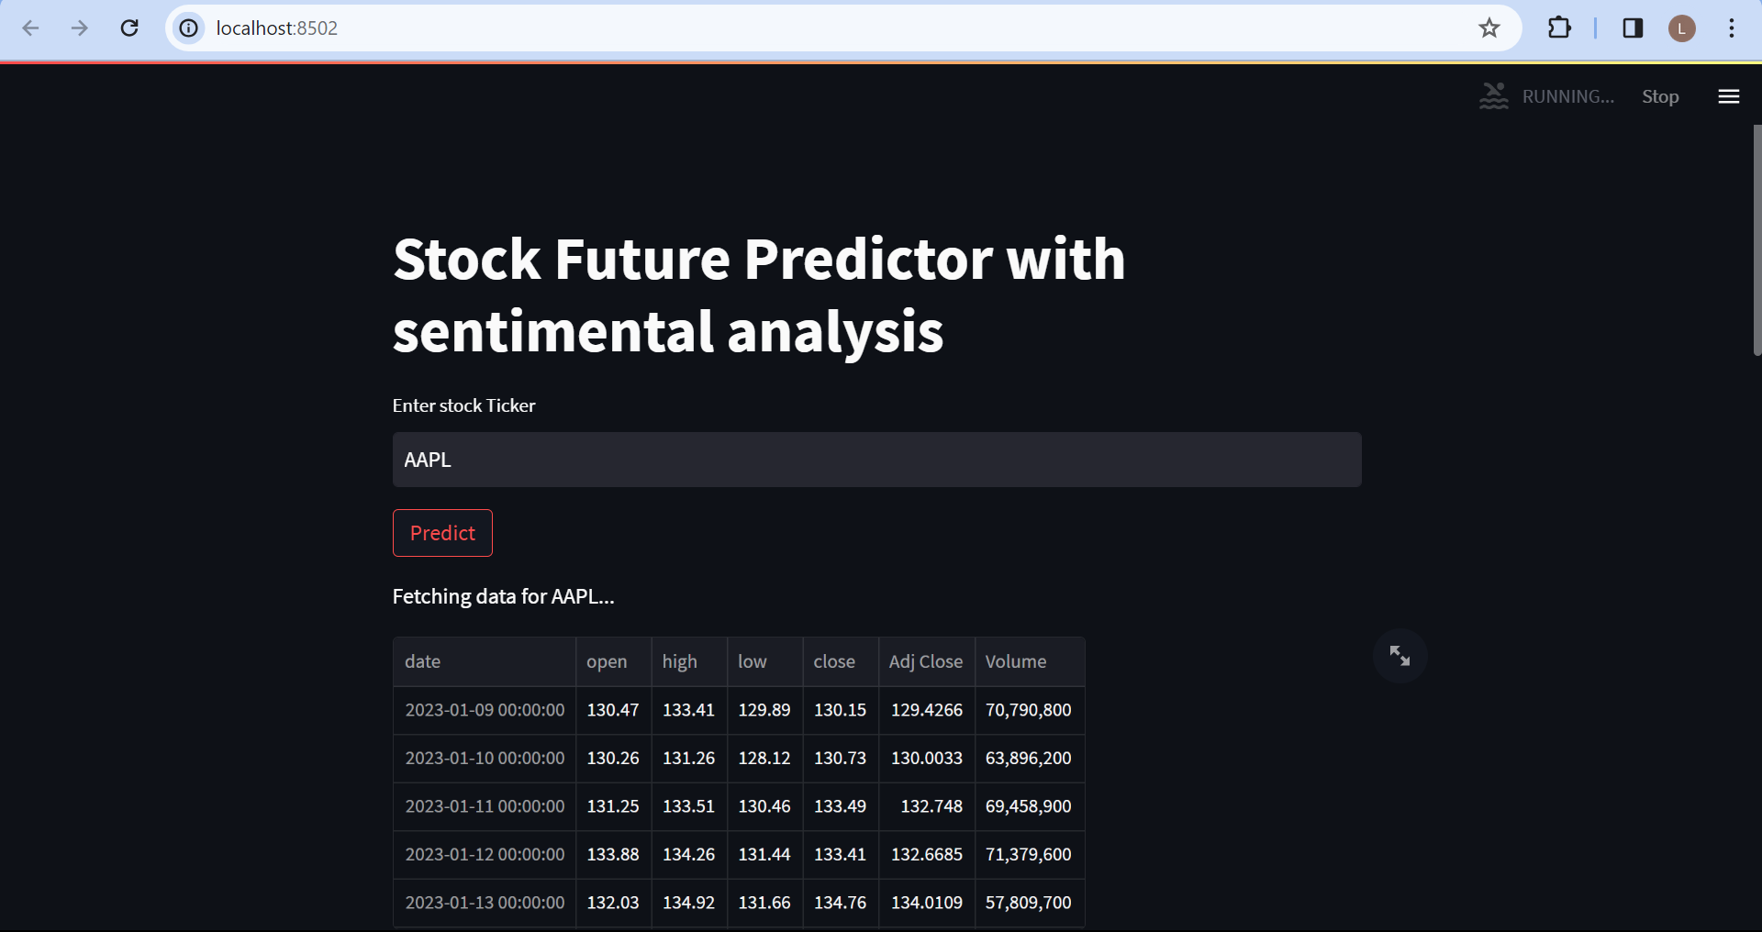
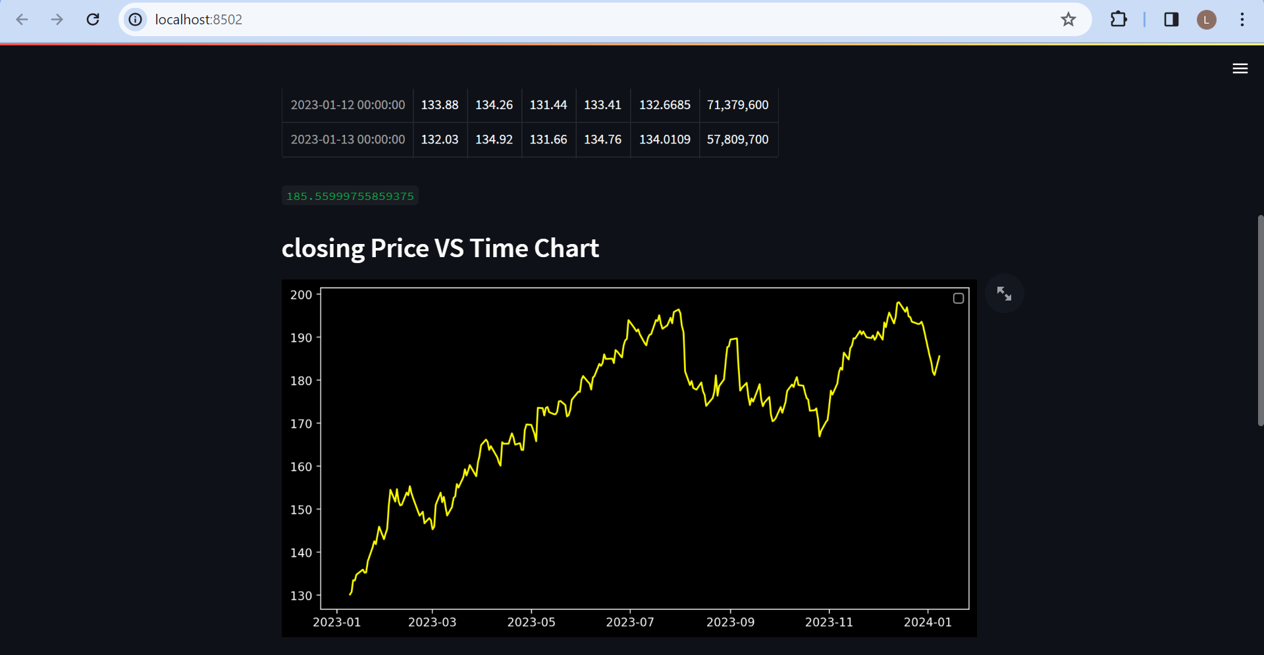
Outcomes / Results Obtained

Slide 22
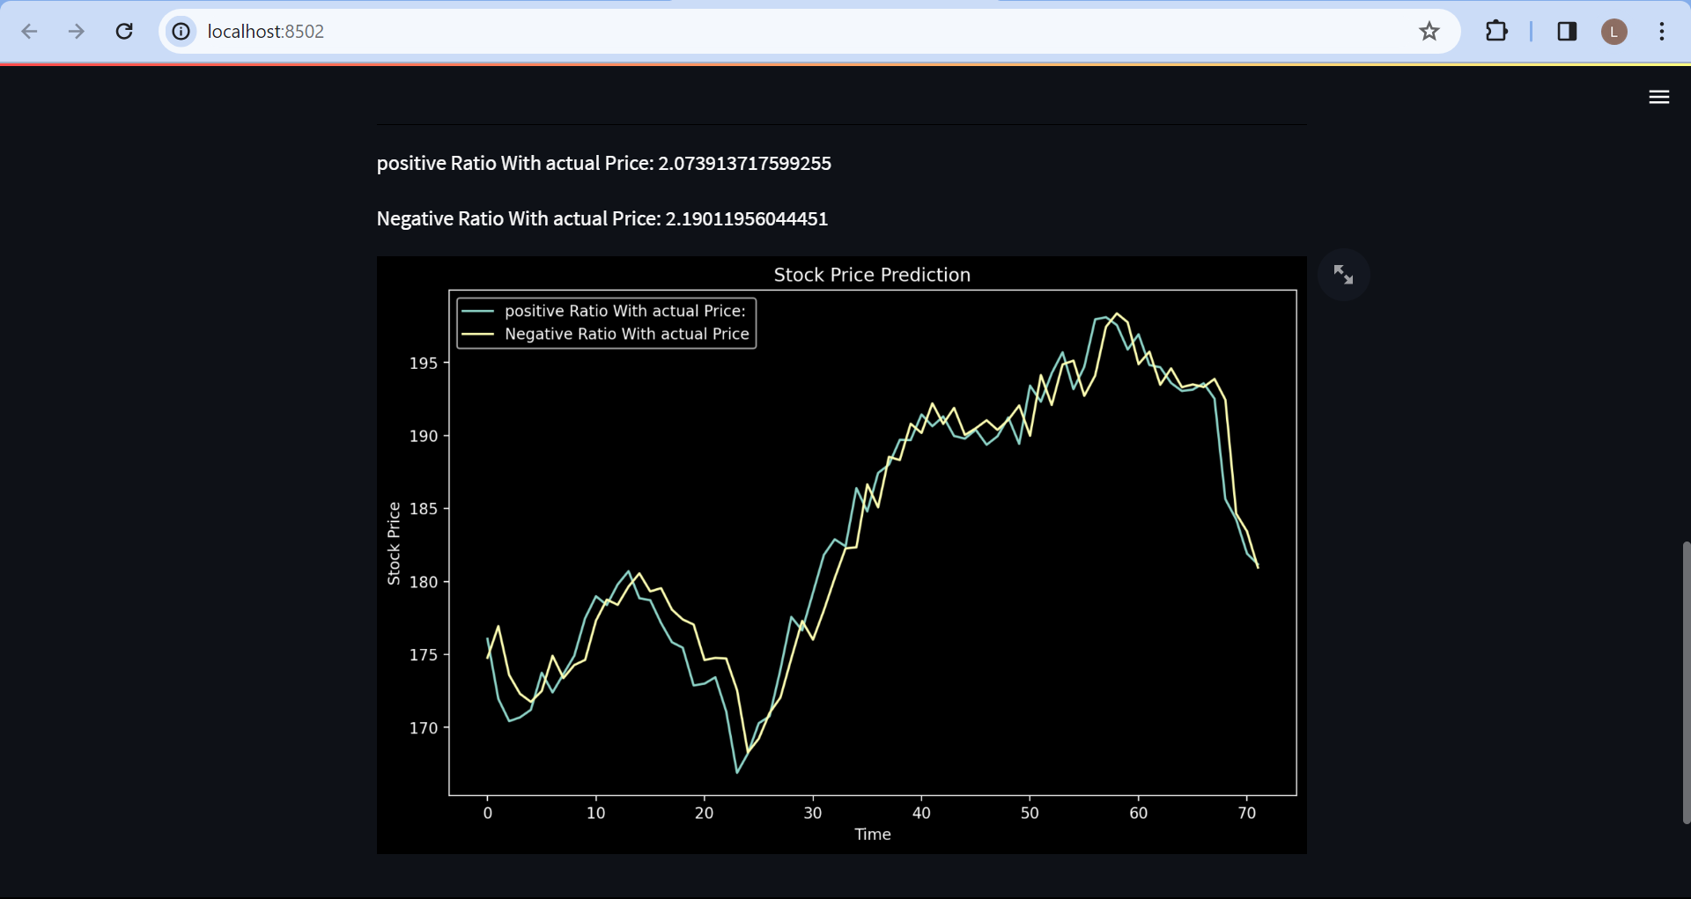
Outcomes / Results Obtained

Slide 23
Conclusion
In the finance world inventory trading is one of the most necessary activities. Stock market prediction is an act of attempting to decide the future price of a stock other monetary instrument traded on a financial exchange. The technical and integral or the time sequence evaluation is used with the aid of most of the stockbrokers while making the inventory predictions. Stock price prediction is still a challenging task due to its natural dynamic and real-time movement. Thus, predicting stock prices are deemed unseeingly. Several techniques are devised in the existing techniques to predict the stock market trends. We proposed a system to predict stock price accurately using machine learning. We used neural networks model to predict the value of stock share in the next day using the previous data about stock market value.
We implemented our proposed system using LSTM (Long Short Term Memory) a RNN (Recurrent Neural Network) algorithm using new stock price dataset and our model is predicting stock price value more efficiently.

Slide 24
References
P. K. Bharne and S. S. Prabhune, "Survey on combined swarm intelligence and ANN for optimized daily stock market price," 2017 International Conference on Soft Computing and its Engineering Applications (icSoftComp), Changa, 2017, pp. 1-6, doi: 10.1109/ICSOFTCOMP.2017.8280083.
Mehar Vijha , Deeksha Chandolab, Vinay Anand Tikkiwalb, Arun Kumar “Stock Closing Price Prediction using Machine Learning Techniques “Procedia Computer Science 167 (2020) 599–606.
Hegazy, Osman & Soliman, Omar S. & Abdul Salam, Mustafa. (2013). A Machine Learning Model for Stock Market Prediction. International Journal of Computer Science and Telecommunications. 4. 17-23.
B. B. P. Maurya, A. Ray, A. Upadhyay, B. Gour and A. U. Khan, "Recursive Stock Price Prediction With Machine Learning And Web Scrapping For Specified Time Period," 2019 Sixteenth International Conference on Wireless and Optical Communication Networks (WOCN), Bhopal, India, 2019, pp. 1-3, doi: 10.1109/WOCN45266.2019.8995080.

Slide 25
References
I. Bhattacharjee and P. Bhattacharja, "Stock Price Prediction: A Comparative Study between Traditional Statistical Approach and Machine Learning Approach," 2019 4th International Conference on Electrical Information and Communication Technology (EICT), Khulna, Bangladesh, 2019, pp. 1-6, doi: 10.1109/EICT48899.2019.9068850.
U. Pasupulety, A. Abdullah Anees, S. Anmol and B. R. Mohan, "Predicting Stock Prices using Ensemble Learning and Sentiment Analysis," 2019 IEEE Second International Conference on Artificial Intelligence and Knowledge Engineering (AIKE), Sardinia, Italy, 2019, pp. 215-222, doi: 10.1109/AIKE.2019.00045.

Slide 26
Publication Details
IRE Journals - International Science & Engineering Academic Research Journal
https://www.irejournals.com/

Slide 27

Thank You

